Slide 1
Touch For Food January 29 Meeting
CloudNine

Slide 2
Agenda
Retrospective Sprint 6
UIR and Test Report
Stakeholder update
Meeting with Dr. Constantinides
Scrum updates w/ presentations
Goals
Schedule
General Issues

Slide 3
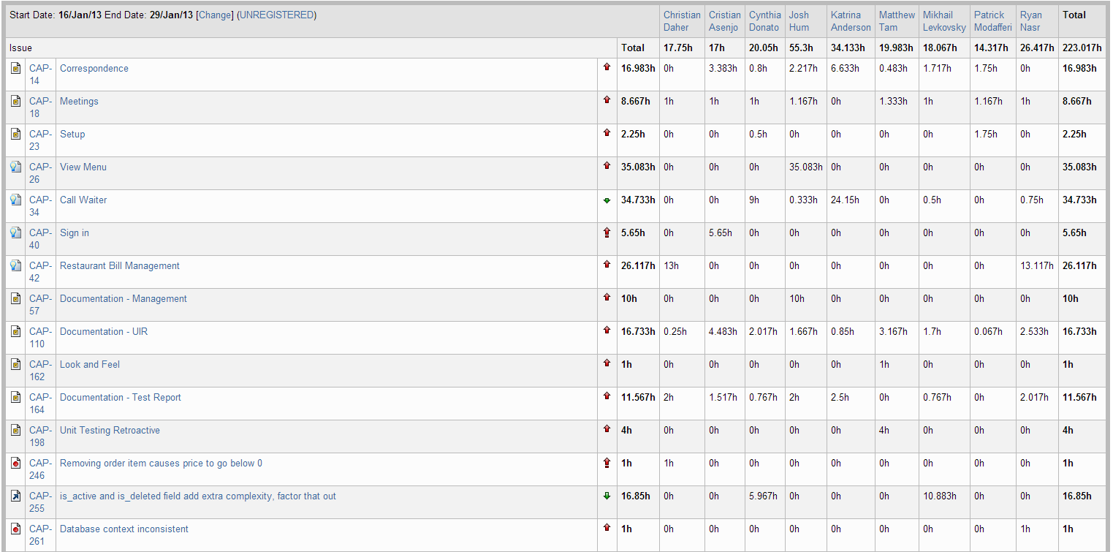
Retrospective – Sprint 6

Slide 4
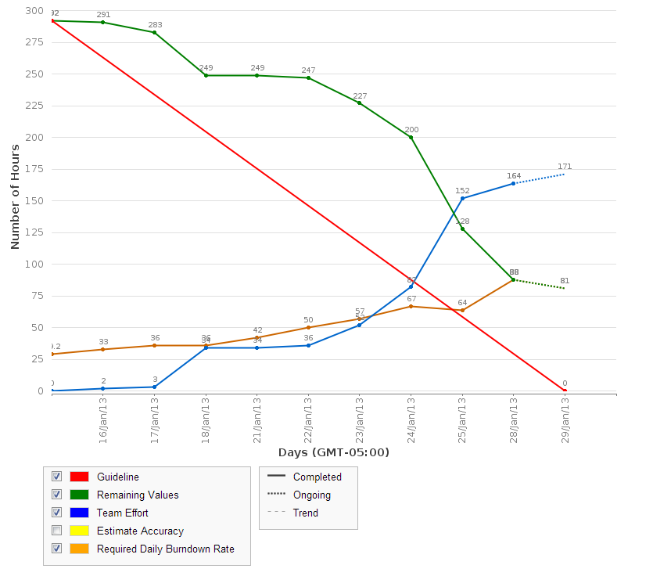
Retrospective – Sprint 6

Slide 5
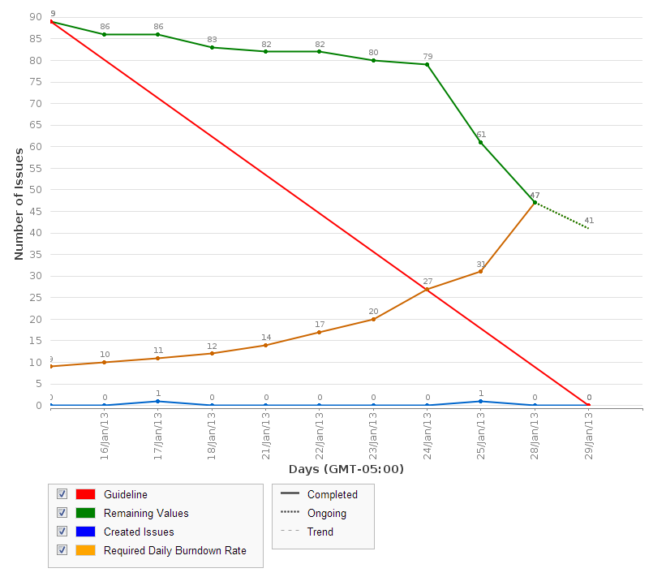
Retrospective – Sprint 6

Slide 6
Retrospective – Sprint 6
Sprint 6 velocity (story points): 11/4 story points
Cumulative velocity (story points): 87 story points
Average velocity (story points): 14.5 story points
Sprint 6 velocity (p-h): 223 person-hours
Cumulative velocity (p-h): 1,070 person-hours
Average velocity per sprint: 179 person-hours

Slide 7
Retrospective – Sprint 6
Total person-hours budgeted to date: 3,726 ph
Total person-hours worked: 1,070 ph
Person-hours budgeted per sprint: 414 ph
Person-hours worked in Sprint 6: 223 ph

Slide 8
Retrospective – Sprint 6
Please resolve any issues that are done but not yet closed
Log your time by Wednesday morning, February 30th
Don’t forget to log all your hours!

Slide 9
UIR and Test Report
Updates?

Slide 10
Stakeholder Update
Meeting with Dr. Grogono next Tuesday, February 5 (during our meeting time)
Must send him docs tomorrow (January 30)
Next meeting will be around one month later (beginning of March)

Slide 11
Meeting with Dr. Constantinides
February 7
Will find out what needs to be prepared
Need to send him login for JIRA and Assembla
How to handle these accounts?

Slide 12
Scrum update w/ presentation
6 minutes each

Slide 13
Scrum update w/ presentation
Sign in
Restaurant Bill Management
View Menu
Call Waiter
Bugs
Finders/Output Mappers
QA
Flow Fixing

Slide 14
Goals
Todo:
Finish search
Finish call waiter
Customer Bill Management
Toppings and Sides
Fix flow, ensure all closed stories work the way they should (data validation, etc.)
Android mobile wrapper (iPhone if there is time)
Reviews?
See backlog for any new tasks/bugs added

Slide 15
Schedule
Sprint 7
SAD
Update docs to hand in
Finish Search
Finish Call waiter
QA
Toppings and sides
Fix flow
Bugs
User history/food reviews?

Slide 16
Schedule
Sprint 8
User history/food reviews
Customer Bill Management
Android wrapper
NFC & QR Code
Bugs
QA
Other features TBD

Slide 17
General Issues
Pulling inactive or deleted data
Decision on how to pass error messages for feedback
Unit tests for Call Waiter
Number of code reviewers
+1 or +2 needed to merge?

Slide 18
General Issues
Code merge standards
Merge trunk into branch first
Time for merge demo?

Slide 19
Questions?

